Slide 1


Task 3
HOTEL AGGREGATOR ANALYSIS
BY: DEEPANSHU JOSHI
PROFILE: DATA ANALYST INTERN
BATCH: MIP-DA-07

Slide 2


Problem Statement
This project aims to analyze a dataset of hotel aggregator listings using Power BI. The dataset comprises various attributes related to listings, hosts, reviews, and availability.

Slide 3



Objectives
The objective is to create comprehensive visualizations and insights that shed light on trends, patterns, and factors influencing listings' performance. Through Power BI, we will explore key metrics such as pricing, availability, host characteristics, and review scores to derive actionable insights for improving the overall quality and competitiveness of the listings.

Slide 4
Dataset Description
id: Unique identifier for each listing.
listing_url: URL of the listing on the hotel aggregator platform.
scrape_id: Identifier for the data scraping event.
last_scraped: Date of the last data scrape.
source: Source of the listing information.
name: Name of the listing.
description: Description of the listing.
neighborhood_overview: Overview of the neighborhood where the listing is located.
picture_url: URL of the listing's picture.
host_id: Unique identifier for the host.
... (and many more columns capturing details about hosts, location, property type, room details, amenities, pricing, availability, reviews, and other relevant information)

Slide 5
Analysis Objectives
Geographical Insights
- Visualize the distribution of listings on a map to identify popular neighborhoods.
- Explore the geographical concentration of listings and host locations
Pricing Analysis & Availability
- Analyze pricing trends based on property types, room types, and accommodation capacity.
- Investigate the availability of listings over time and identify peak periods.
Host Performance
- Evaluate host characteristics, including superhost status, response times, and verification methods.
- Explore correlations between host attributes and listing performance.
Review Score & Guest Statisfaction
- Examine review scores and their impact on overall listing performance.
- Identify areas for improvement based on specific review categories.
Property Type and Room Analysis
- Analyse the distribution of property types and room types.
- Explore trends in the popularity of specific accommodation setups.

Slide 6
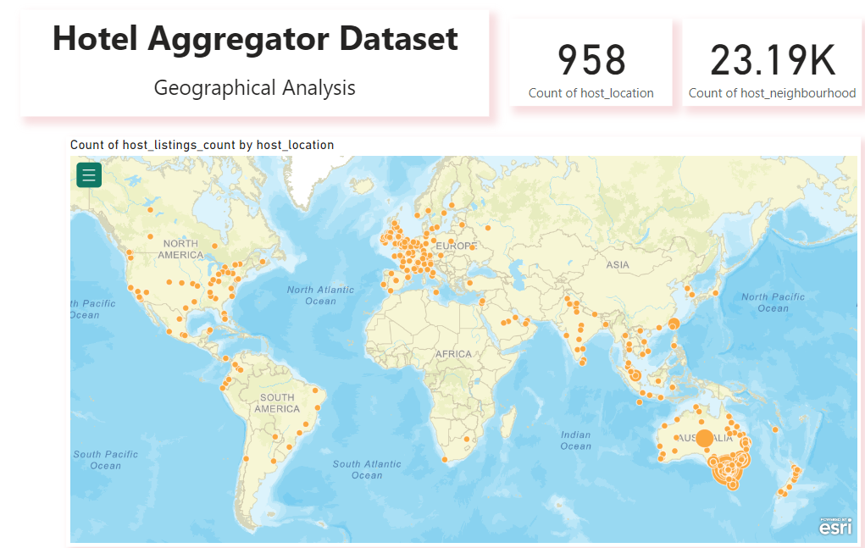
Geographical Insights
The dataset for Geographical Analysis encompasses a total of 958 host locations spread across various continents including Europe, Australia, Asia, Africa, North America, and South America. Additionally, it comprises 23,019 neighborhoods.
The primary objective of this dataset is to identify the most frequently inhabited locations, with the findings indicating that Europe emerges as the predominant region in terms of host residency.

Slide 7
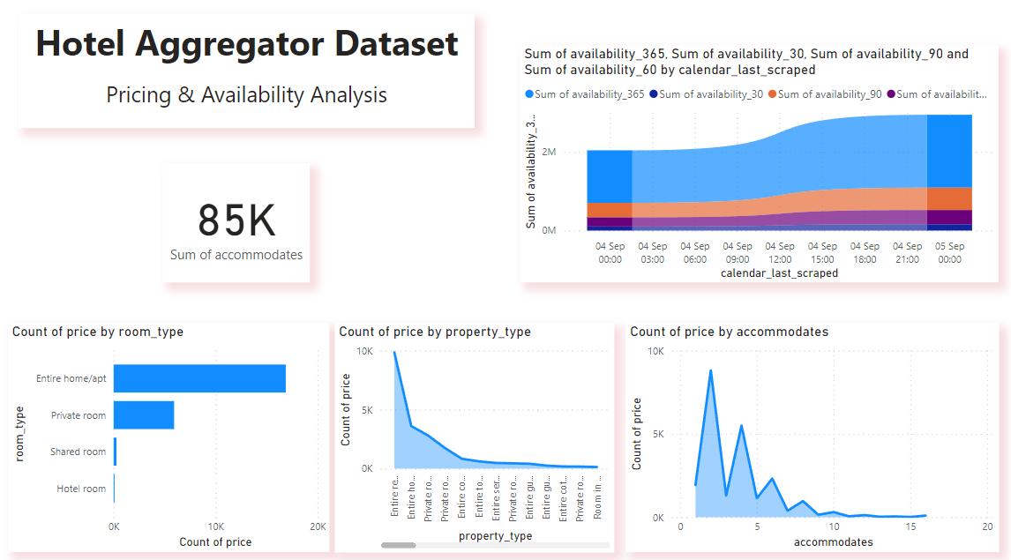
Pricing and Availability Analysis
Entire home/apt had the highest Count of price at 16,887, surpassing Hotel rooms by 18,874.16%.
Entire home/apt accounted for 72.84% of Count of price, followed by Private rooms, Shared rooms, and Hotel rooms.
Count of price ranged from 89 to 16,887 across all room types.
Entire rental unit had the highest Count of price at 9,862, representing 42.54% of the total.
2 had the highest Count of price at 8,821, with a 62,907.14% difference from the lowest count.
Availability was highest on September 5, 2023.

Slide 8
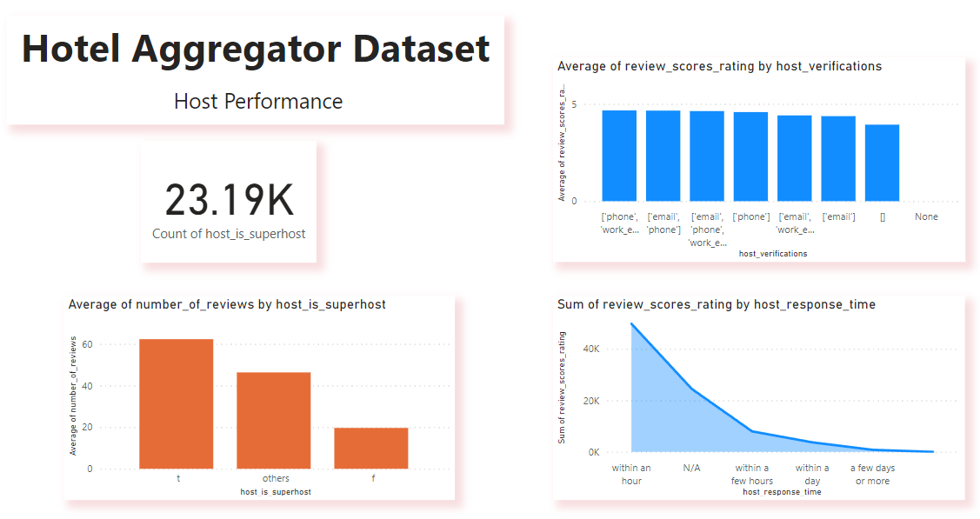
Host Performance
The dataset indicates a substantial presence of superhosts, totaling 23.19k.
"t" achieved the highest Average of number_of_reviews at 62.29, followed by "others" at 46.32 and "f" at 19.64.
"within an hour" accumulated the highest Sum of review_scores_rating at 49,765.70, representing 57.38% of the total.
['phone', 'work_email'] achieved the highest Average of review_scores_rating at 4.67, with ratings ranging from 0 to 4.67 across all host verifications.

Slide 9
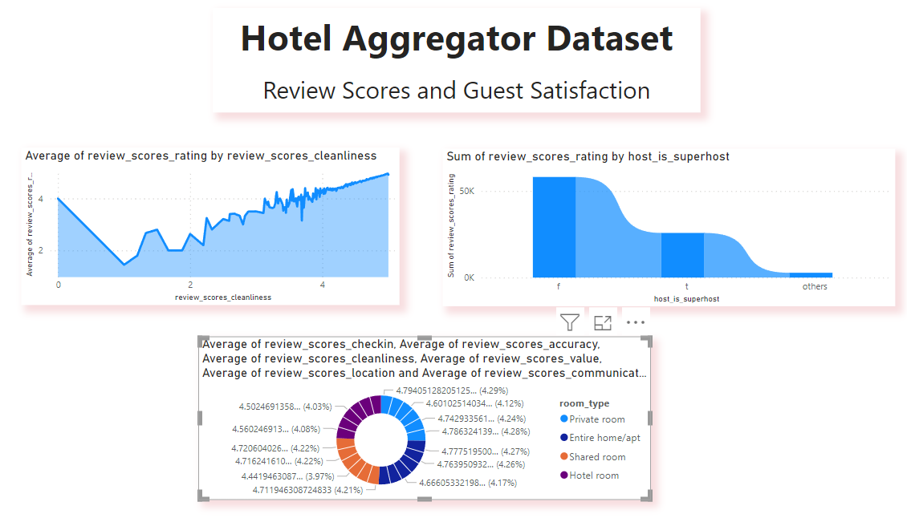
Review Scores and Guest Satisfaction
"4.99" had the highest Average of review_scores_rating at 4.96, exceeding the lowest rating by 9,133.98%.
"f" led with the highest Sum of review_scores_rating at 58,134.81, accounting for 67.03% of the total.
"Private room" achieved the highest Average of review_scores_checkin at 4.79, 5.13% higher than "Hotel room."
Across all room types, ratings for review_scores_checkin ranged from 4.56 to 4.79.

Slide 10
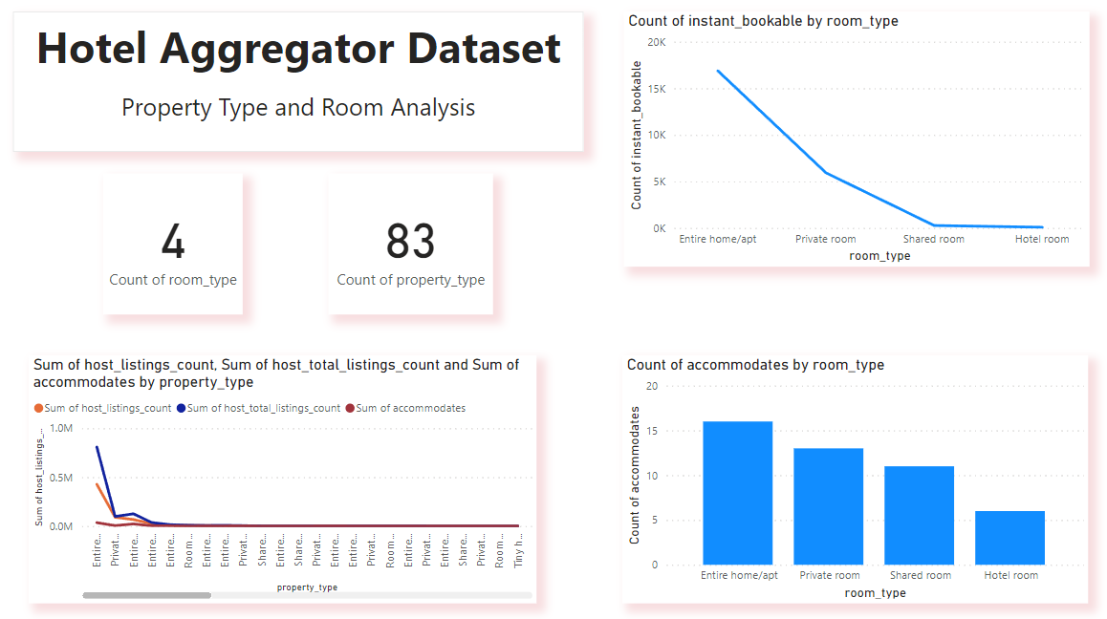
Property Type and Room Analysis
Host Listings: Positive correlation between host_listings_count and host_total_listings_count. “Entire rental unit” makes up 64.80% of host_listings_count.
Accommodates: “Entire home/apt” leads with an average count of 16, which is 166.67% higher than “Hotel room”.
Instant Bookable: “Entire home/apt” has the highest count at 16,887, which is 18,874.16% more than “Hotel room” and represents 72.84% of the total instant_bookable counts.
These statistics highlight the dominance of “Entire home/apt” in the market in terms of availability and guest capacity.

Slide 11



Recommendation
Focus marketing efforts on Europe, the primary region with a substantial host residency presence.
Promote entire home/apt accommodations to capitalize on their popularity and high demand.
Incentivize hosts to maintain superhost status to ensure excellent guest experiences.
Encourage positive reviews and offer instant booking options to enhance property visibility and attract more renters.
Diversify property portfolio to offer a range of options to cater to diverse renter preferences.
Optimize property management practices to maximize occupancy rates and rental income.

Slide 12

About
Thank You
FOR YOUR ATTENTION

